Slide 1
1. Introduction
Training Workshop for IONIC framework

Slide 2
Contents
1.1 Workshop schedule
1.2 Introduction to IMM
1.2.1 Objectives
1.2.2 Wireframe of IMM app
1.2.3 API specification
1.3 Resources for workshop

Slide 3
1.1 Workshop schedule
Lecture and Practice during 4 Days
Build
API Server
with Node.js, Express and MongoDB
Introduction to Frameworks and Tool Installation
Implement Front-end with Ionic

Slide 4
1.1 Workshop schedule
Day1
Introduction
Explanation of course purpose
Overall structure
Setup tool installation
The Process of Designing Wireframe

Slide 5
1.1 Workshop schedule
Day2
Creating APIs
Simulation of an Ionic Template
Explanation of Ionic Application
Implementation of IMM Pages
Create a Home page
Create an About-museum page
Create a Map page

Slide 6
1.1 Workshop schedule
Day3
Creating an REST API
Running server on EC2 instance
Implementing IMM Pages
Using native plugin for QR code scanner
Build for android

Slide 7
1.1 Workshop schedule
Day4
Using github and node.js on EC2 instance
Build for iOS
Wrap up and Review

Slide 8
1.2 Introduction to IMM
1.2.1 Objectives
The goal of this project is to make IMM app for android and iOS using Ionic framework which is a cross-platform application development framework.
IMM(International Mountains Museum) app is a museum guide app based on the Interactive multimedia information multicast for museum/galleries project of Gandaki College of Engineering and Science(GCES)
IMM app is developed for training workshop.

Slide 9
1.2 Introduction to IMM
1.2.2 Wireframe of IMM app
All contents related to the exhibitions and items of International Mountains museum was provided Gandaki College.

Slide 10
1.2 Introduction to IMM
1.2.2 Wireframe of IMM app
IMM app consists of 12 pages.
Home page
About-museum page
Map page
Exhibition page
Category page
Section page
Item page
Facility page
Facility-detail page
Facility-library page
Facility-gorkha page
Search page

Slide 11
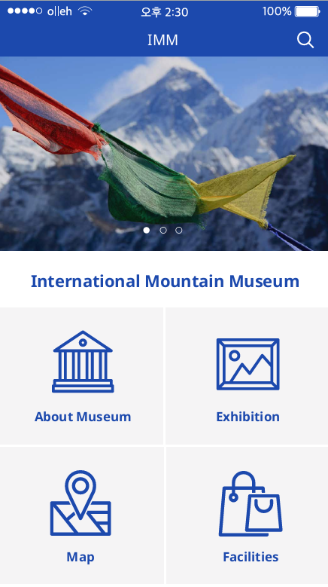
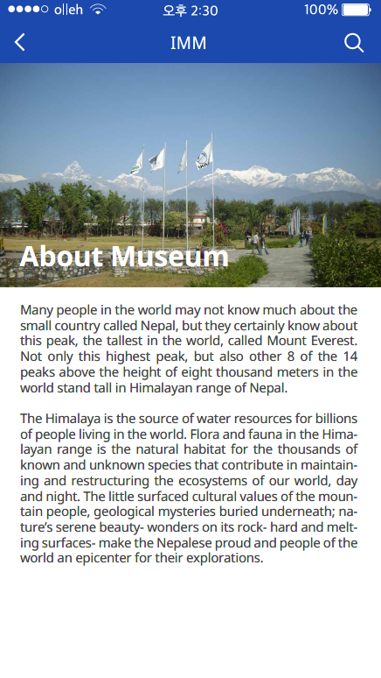
1.2 Introduction to IMM
1.2.2 Wireframe of IMM app
Home Page
About museum Page

Slide 12
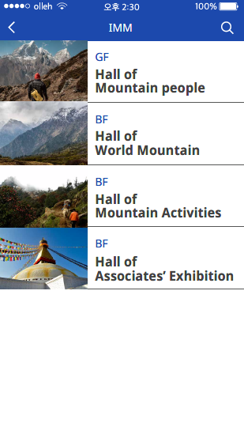
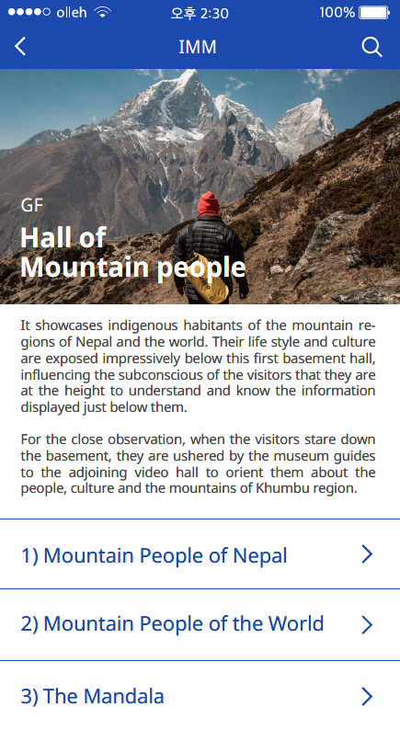
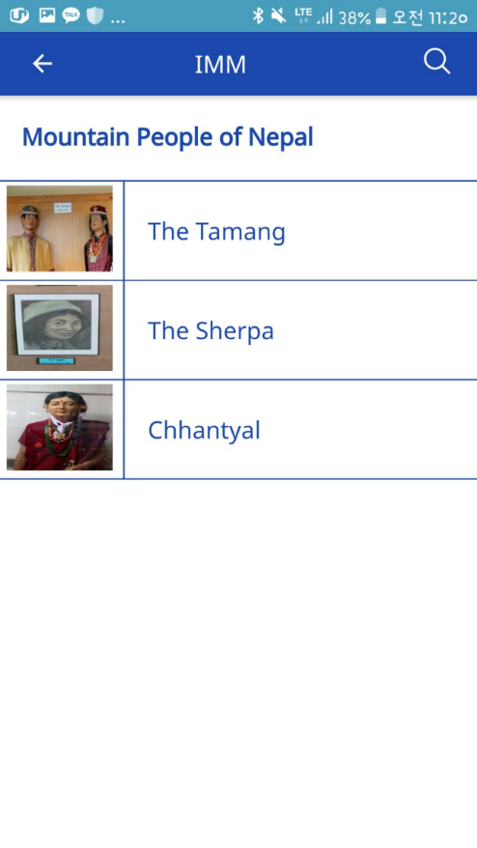
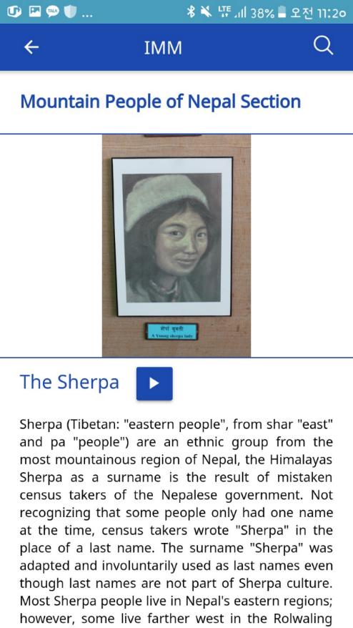
1.2 Introduction to IMM
1.2.2 Wireframe of IMM app
Exhibition Page
Category Page
Section Page
Item Page

Slide 13
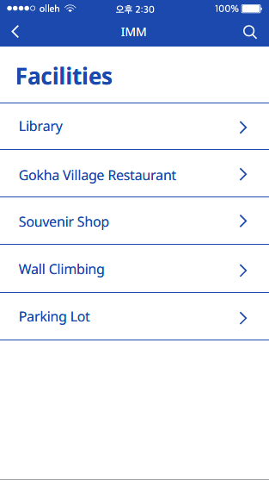
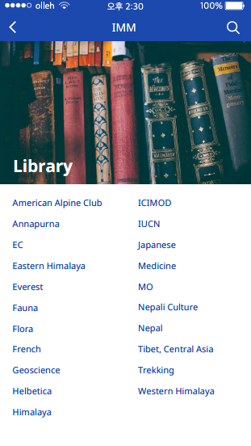
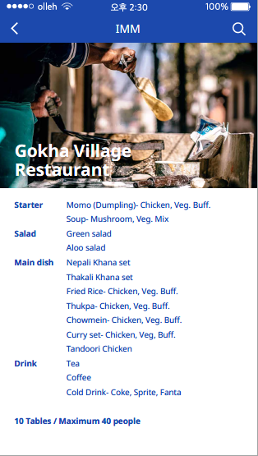
1.2 Introduction to IMM
1.2.2 Wireframe of IMM app
Facility Page
Facility-library Page
Facility-gorkha Page

Slide 14
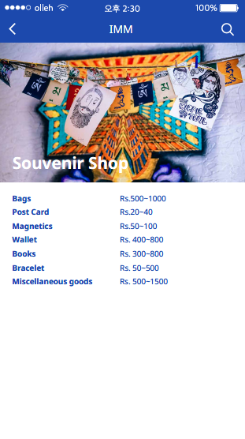
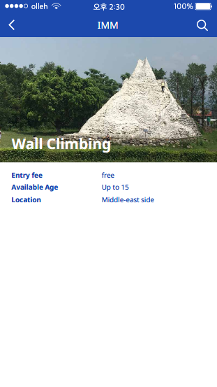
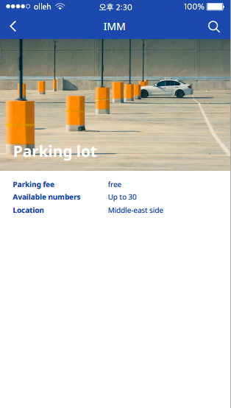
1.2 Introduction to IMM
1.2.2 Wireframe of IMM app
Facility-detail Page
Facility-detail Page
Facility-detail Page

Slide 15
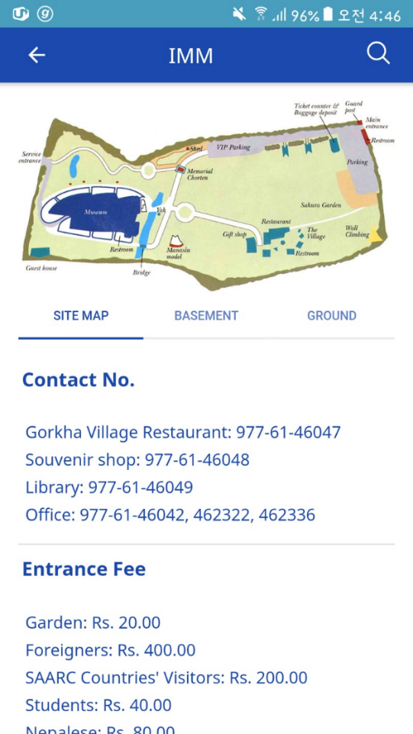
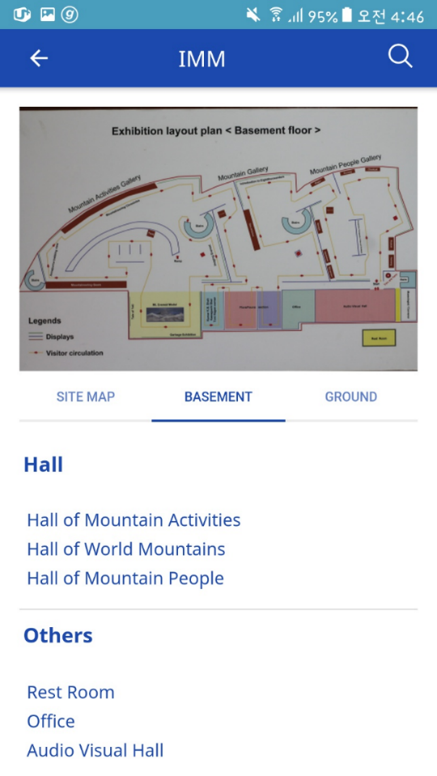
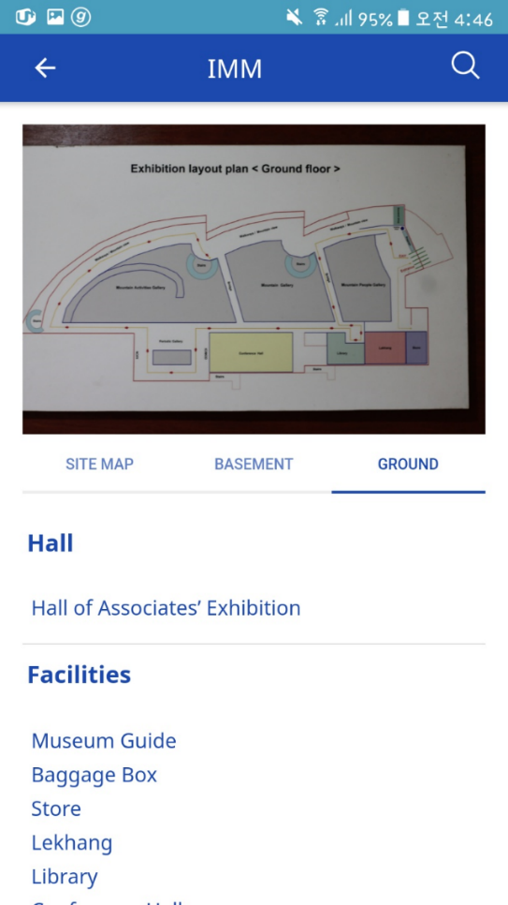
1.2 Introduction to IMM
1.2.2 Wireframe of IMM app
Map Page
Map Page
Map Page

Slide 16
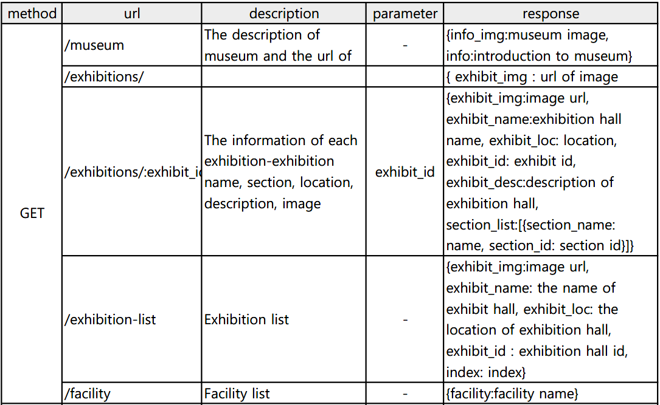
1.2 Introduction to IMM
1.2.3 API specification

Slide 17
1.2 Introduction to IMM
1.2.3 API specification

Slide 18
1.3 Resources for Workshop
All resources that we will use for implementing IMM app are provided in Github repository.
https://github.com/YSCho-HGU/Museum-Nepal.git
For Lab1, Lab2, Lab3, Lab4, Lab6, there are source code and other materials(ex. image files), so download all resources in this repository.
Resources related to International Mountains Museum are provided by the project team of Gandaki College.
All of the resources in this Github repository are not commercially available.
It can not be used for any purpose other than education.

